Slide 1
ART
What is the
definition
of art?
the expression or application of human creative skill and imagination, typically in a visual form such as painting or sculpture, producing works to be appreciated primarily for their beauty or emotional power
works produced by human creative skill and imagination
Mrs. Sordyl
Fundamentals of Art Class

Slide 2
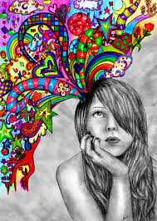
An artist learns
to
use their imagination
to make
a new creation

Slide 3
A variety of supplies are used
by artists to convey his or her
visual message and personal techniques.

Slide 4
There is no art without
the artist!

Slide 5
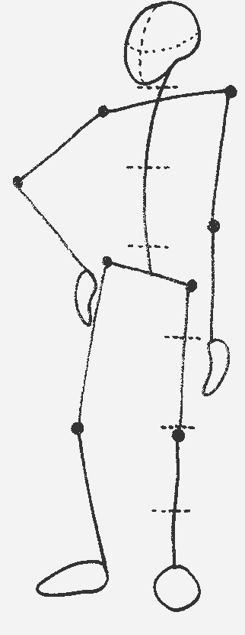
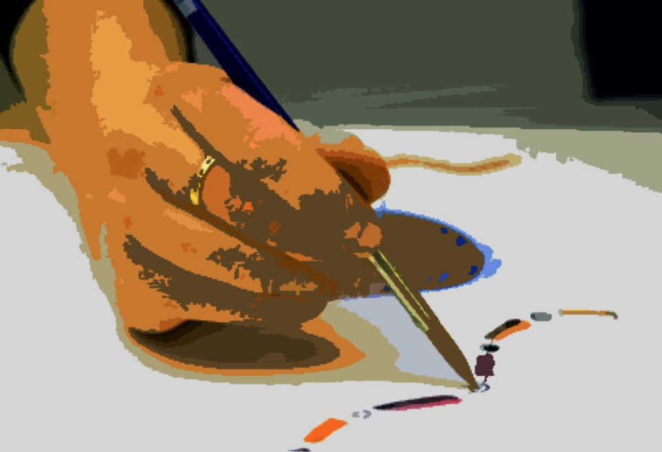
Artist +
+ medium
= ART

Slide 6
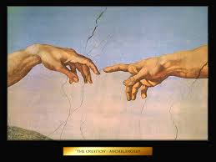
Michelangelo is quoted as saying, "A man paints with his brains and not with his hands."

Slide 7
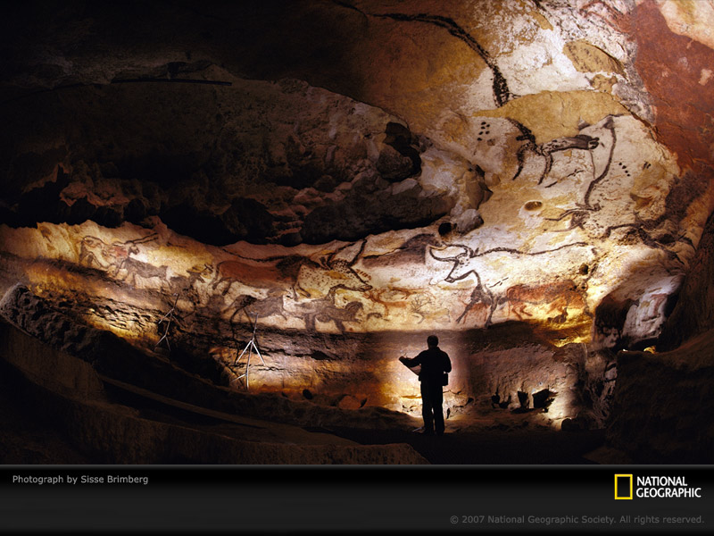
Art created over 17,000 years ago show primitive man had a creative spirit.
http://www.youtube.com/watch?v=UnSq0c7jM-A
Lascaux Caves, France

Slide 8
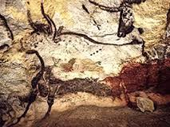

Slide 9
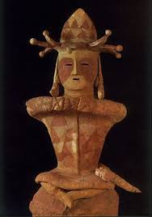
Art in a way unites our human species. Why have so many cultures created art representing their culture and values?

Slide 10
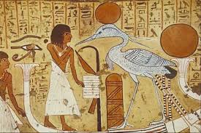
What do we know
about cultures
from their creations?

Slide 11
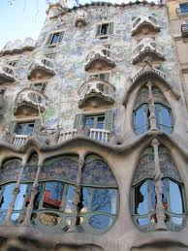
How has artistic vision
changed the landscape of
Earth?

Slide 12
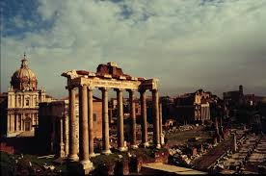
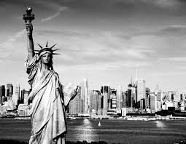

Slide 13
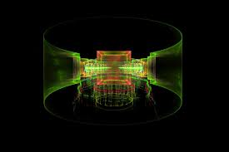
How does art reflect society and
the advances made in science
and technology?

Slide 14
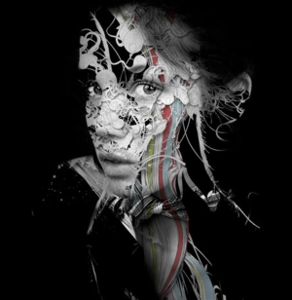

Slide 15
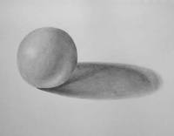
What will you learn
about in this
Fundamentals
of Art Class?

Slide 16
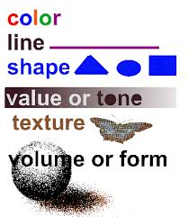
You will be learning about
the Elements of Art.

Slide 17
The Principals of Art
The principles of art generally deal with the way the elements of art are composed within the work of art. So, the principles of art typically deal with composition. The principles tend to be more fluid than the elements meaning that opinions vary on what the principles really are. I suggest that there are eight concrete principles of art, and few others that would be considered art fundamentals. The eight principles of art are balance, proportion, unity, harmony, variety, emphasis, rhythm, and movement. All of these principles clearly deal with the placement of elements within artwork.

Slide 18
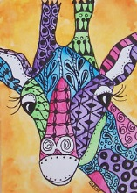
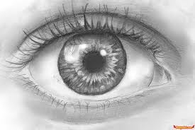
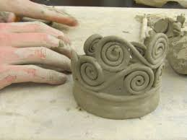
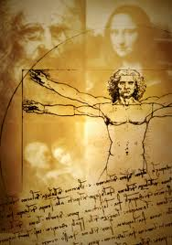
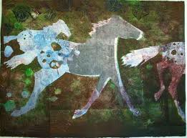
You will explore...
Drawing
Painting
Art History
Ceramics
Printmaking

Slide 19
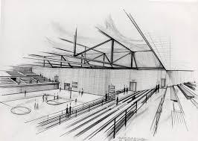
The arts teaches to make good judgments about qualitative relationships. Unlike much of the curriculum in which correct answers and rules prevail, in the arts, it is judgment rather than rules that prevail.
See more at:
http://www.arteducators.org/advocacy/10-lessons-the-arts-teach#sthash.QClyXKrU.dpuf

Slide 20
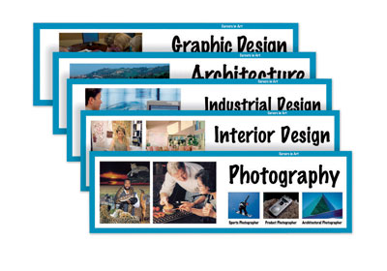
There are many possible careers choices
for the intrigued artist…
http://www.davisart.com/Portal/TeacherResources/ArtAdvocacy/Careers.pdf

Slide 21
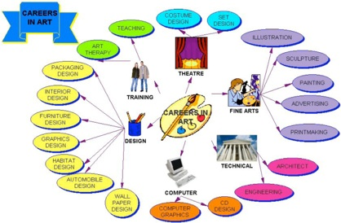

Slide 22
I would like to take this opportunity to welcome you to visual arts program. This is an excellent opportunity for students to get an introduction to basic concepts for acquiring skills in both 2-D and 3-D design. Concepts and vocabulary of Elements and Principles of Design will be introduced and reinterpreted through student assignments and projects. Student will have hands-on learning using a variety of media used in this course including pencil, paint, watercolor, clay, and printmaking tools. Students will use problem solving to develop artworks. Students will critique their artwork based on the elements of art and principles of design.

